Slide 1
er

Slide 2
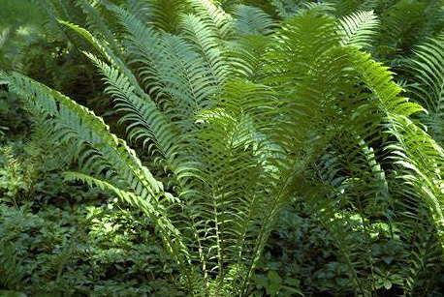

Slide 3
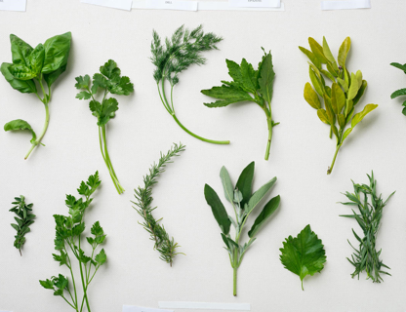

Slide 4
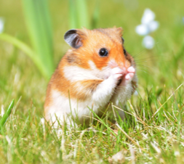

Slide 5
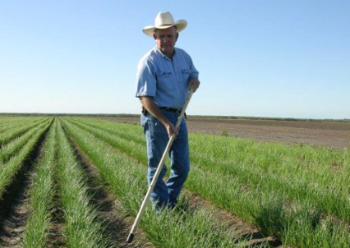

Slide 6
after dinner
hunter letter
longer

Slide 7
ure

Slide 8
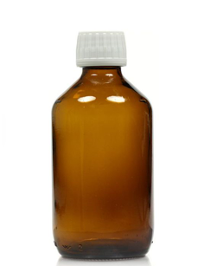
ure

Slide 9

ure

Slide 10
sure pure cure
secure
manure mature

Slide 11
Do teeth feel sharp?
Can a shark sit in a chair?
Can a torch light up a porch?
Is all hair fair?

