Slide 1
sh ng ai ou oa ee or ie

Slide 2
oi air ue

Slide 3
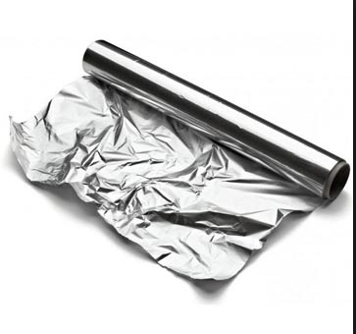


Slide 4
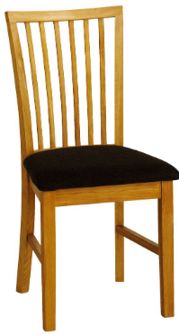
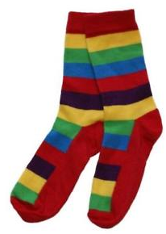

Slide 5
coin foil join
chair fair stairs
statue fuel duel

